Slide 1
MICROECONOMICS
(BCS 2002 & BSE 2002)/BA]
SPRING-2024
Dr. S. Ghiasul Haq ghiasul786@gmail.com

Slide 2
(C) DEMAND AND SUPPLY

Slide 3
MARKET EQUILIBRIUM
LECTURE-9

Slide 4
1.MARKET EQUILIBRIUM PRICE &QUANTITY
DEFINITION:
Equilibrium price and quantity are when there is no shortage or surplus of a product in the market at a price . Supply and demand intersect, meaning the amount of an item that consumers want to buy is equal to the amount being supplied by its producers at the market price. In other words, the market has reached a perfect state of balance as prices stabilize to suit both the buers and sellers .

Slide 5
2.MARKET EQUILIBRIUM PRICE &QUANTITY
Equilibrium quantity is when supply equals demand for a product.
The supply and demand curves have opposite trajectories and eventually intersect, creating price equilibrium and equilibrium quantity.
Hypothetically, this is the most efficient state the market can reach and the state to which both quantity and price naturally gravitate.

Slide 6
3. DEMAND & SUPPLY OF BANANAS [000 DOZENS
PRICE | DEMAND | SUUPLY | SURPUS
PER DOZEN |  |  | SHORTAGE
30 | 90 | 10 | -80
35 | 80 | 20 | -60
40 | 70 | 30 | -40
45 | 60 | 40 | -20
50 | 50 | 50 | 0
55 | 40 | 60 | 20

Slide 7
DEMAND & SUPPLY OF BANANAS [000 DOZENS
PRICE | DEMAND | SUUPLY
 |  |  | SURPLUS/ SHORTAGE
PER DOZEN
100 | 90 | 10 | -80
120 | 80 | 20 | -60
140 | 70 | 30 | -40
160 | 60 | 40 | -20
180 | 50 | 50 | 0
200 | 40 | 60 | 20
220 | 30 | 70 | 40
240 | 20 | 80 | 60
260 | 10 | 90 | 80

Slide 8
4. MARKET EQUILIBRIUM
Market Equilibrium:
Q _{S} = Q _{D}
-Qs =Quantity Supplied
-Qd = Quantity Demanded

Slide 9
….4. PRICE EQUILIBRIUM
1. Demand Equation: [D= a- bP] D= 40-2P
2. Supply Equation: [S= a +bP] S= 22 + 4P
3. Equilibrium Price-Price Per Unit:
D = S
40-2P = 22+ 4P
40 -22 = 4P+2P
6P = 18
P =18/8
P = 3
The equilibrium price =Rs. 3 Per Unit

Slide 10
…4.CLASS EXERCISE:
D= 40-2P S= 22 + 4P
Find the Surplus at price 4 Per Unit[-Price above the Equilibrium price]
(ii) Find the Shortage at Price 2 Per Unit [-Price
below the equilibrium price]

Slide 11
…4 CLASS EXCERCISE.SOLUTION =:
D= 40-2P S= 22 + 4P
(i) Rs. 4 Per Unit:
Demand =32 Supply = 38 Surplus =6
(ii) Rs. 2 Per Unit:
Demand =36 Supply = 30 Shortage = 6

Slide 12
5.SHIFT IN MARKET EQUILIBRIUM PRICE
The market price of a product converges back to equilibrium price if there is any temporary shift in price above or below the equilibrium price. THEN WHY PRICES OF GOODS PERMANENTLY CHANGES IN BOTH DIRECTIONS. CHANGES, (OTHER THAN PRICE) IN THE DETERMINANTS OF SUPPLY AND/OR DEMAND RESULT IN A NEW EQUILIBRIUM PRICE AND QUANTITY. WHEN THERE IS A CHANGE IN SUPPLY OR DEMAND, THE OLD PRICE WILL NO LONGER BE AN EQUILIBRIUM. INSTEAD, THERE WILL BE A SHORTAGE OR SURPLUS, AND PRICE WILL SUBSEQUENTLY ADJUST UNTIL THERE IS A NEW EQUILIBRIUM.. (Explained graphically in next slides)

Slide 13
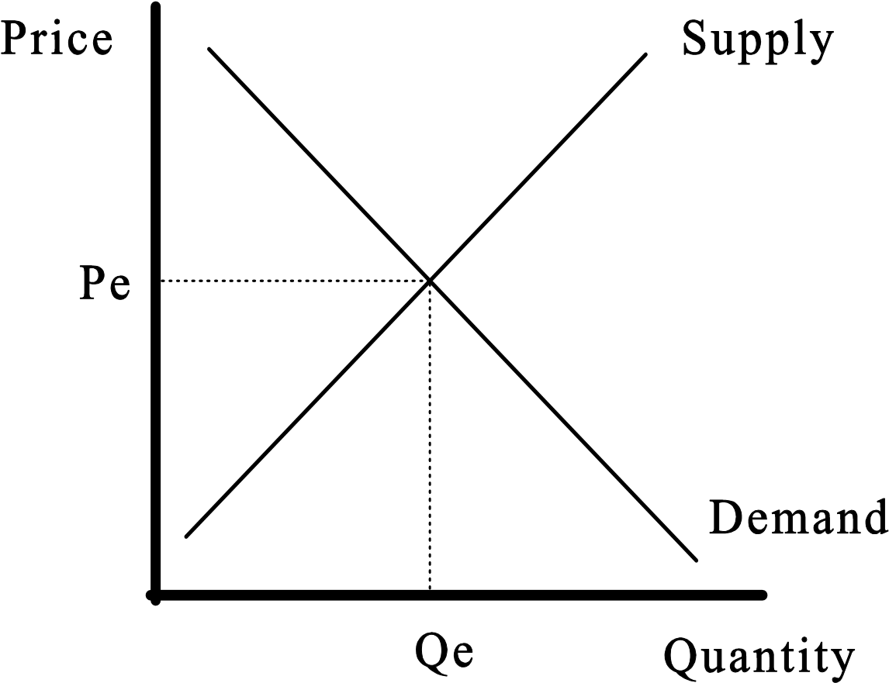
Demand Curve is Qd = 22 - P
Supply Curve is Qs = 10 + P
EQ: Price = 22 - P = 10 + P
12 = 2P and
Pe = 6
WITH PRICE Qe=16
6
16
Shifts in Supply and Demand in the market result in new equilibria.
(Next Slides):

Slide 14
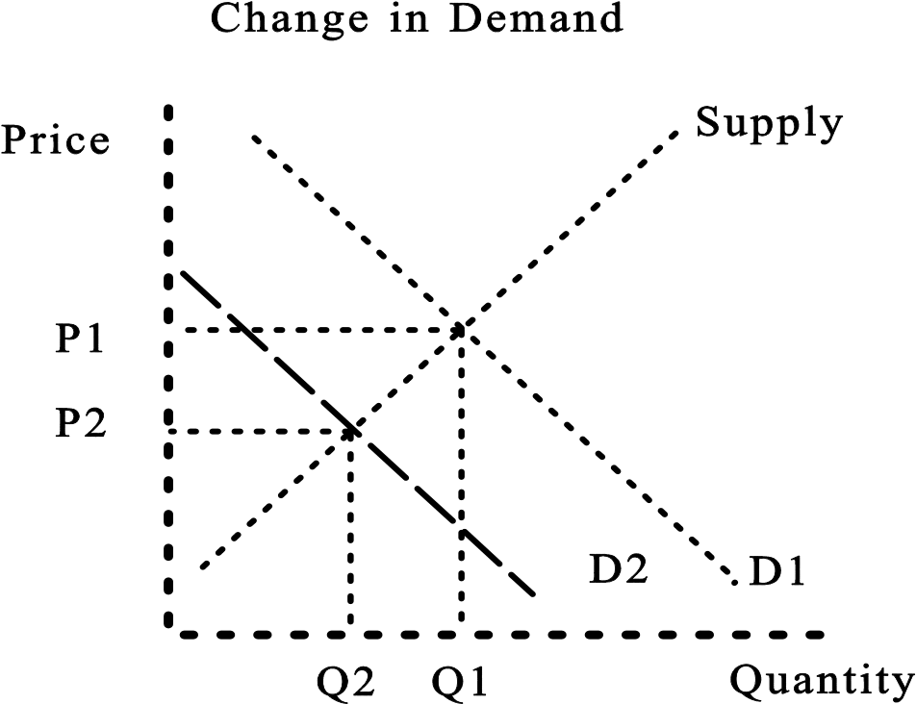
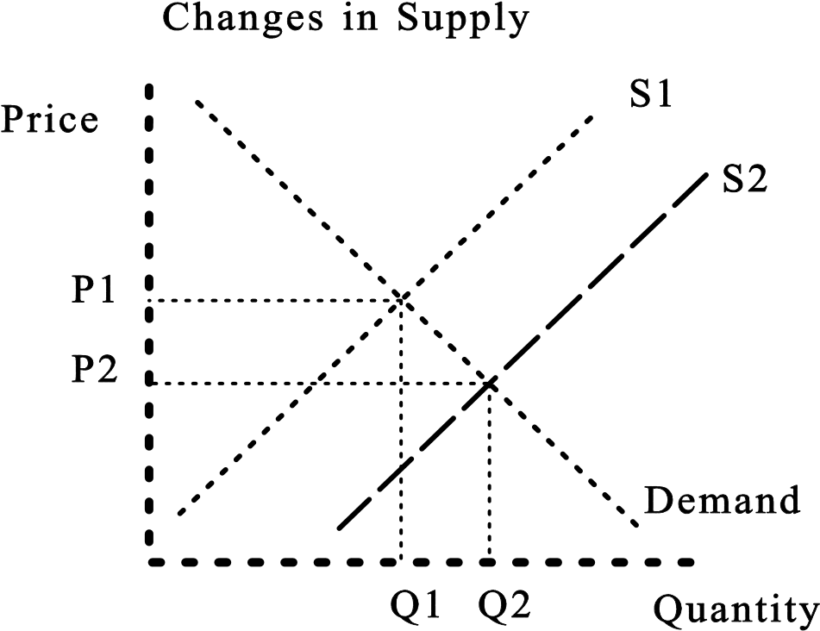
Shift in Demand
1-Shift in Demand D2 to D1
Shift in Supply
2-Shift in Supply S1 to S2

Slide 15
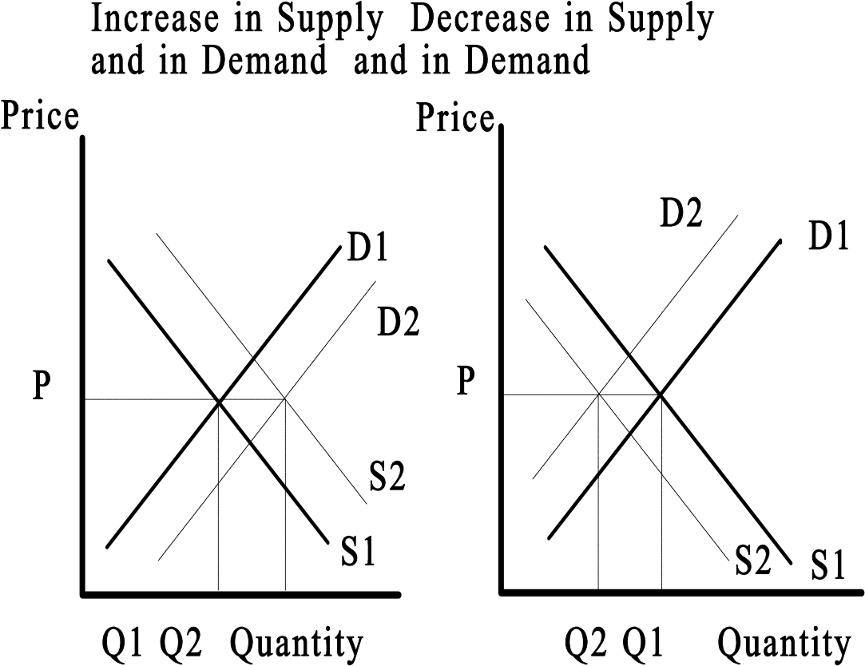
3-Upward Shift in Demand & Supply
4 -Downward Shift in
Demand & Supply

Slide 16
6.FIXATION OF PRICES BY THE GOVERMNET

Slide 17
We economists may not know much, but we know one thing very well, and that's how to create shortages and surpluses. Just tell us which you want!
If you want a shortage, all we have to do is to set a price that's below the market price and I'll guarantee you a shortage. If you want a surplus, set a price too high and you'll have your surplus.
Milton Friedman:

Slide 18
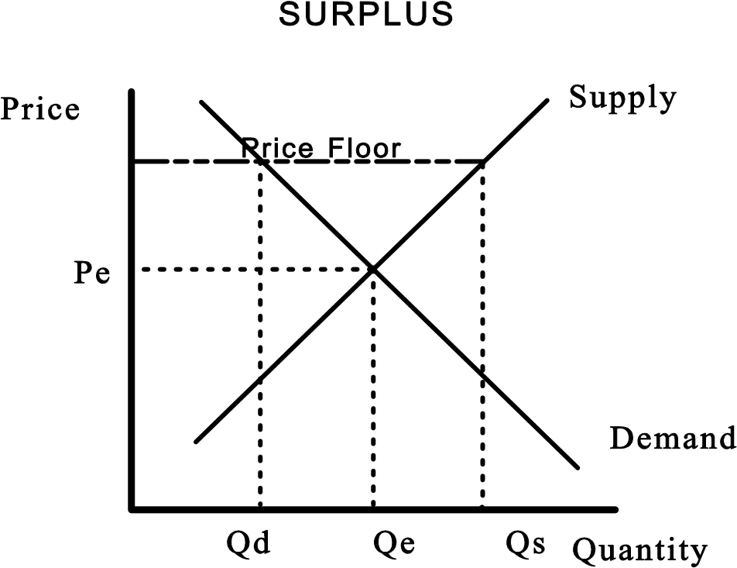
..6. FIXATION OF PRICES BY THE GOVERMNET
(a) Surplus is caused by an effective price floor (i.e., the minimum guaranteed price)

Slide 19
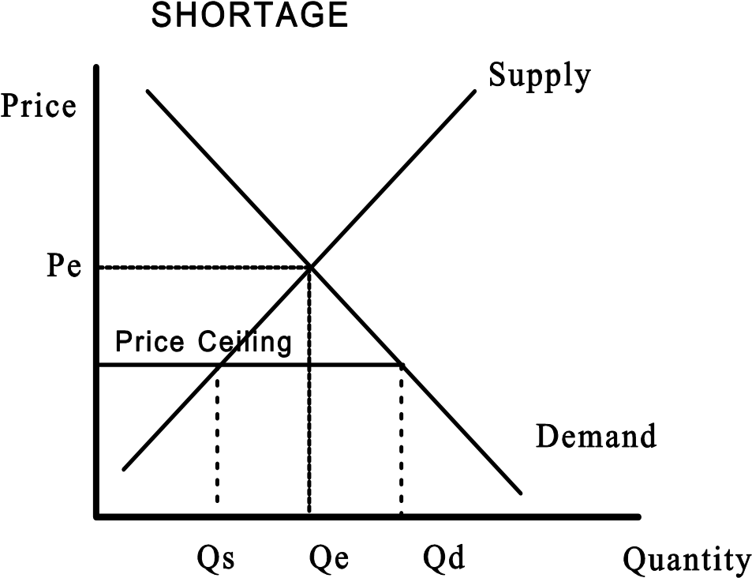
…6. FIXATION OF PRICES BY THE GOVERMNET
(b) Shortage is caused by an effective price ceiling (the maximum price that can be charged for the product).

Slide 20
7. Consumer & Producer Surplus:
(i) Consumer Surplus [Already discussed)
(ii) Producer Surplus: There are always some producers who may get a higher market price for their products though they are ready o sell at lower price. (All the supply curve points below the equilibrium price) and they enjoy Surplus due favorable market conditions. In other words The producer surplus is the difference between the market price and the lowest price a producer is willing to accept to produce a good.
Graphically (figure on next Slide) producer surplus is the inner triangular area between the equilibrium price and the supply curve. (And Consumer surplus is the inner triangular area between the equilibrium price and the demand curve).

Slide 21
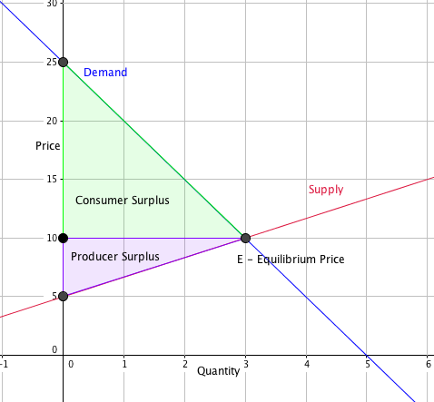
…7. Consumer & Producer Surplus:

